Slide 1

Linear Algebra – Lecture #16 Projections
By Ariel Guerrero
ariel.guerrero@uc.edu.py
+595 (981) 425 040

Slide 2
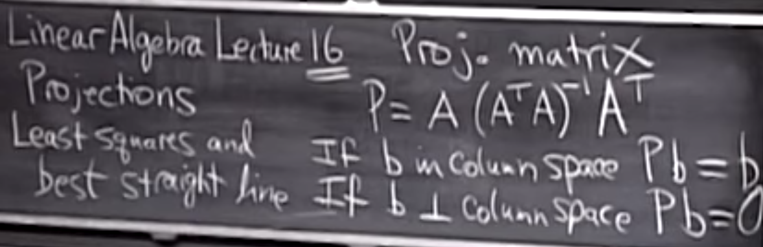
Linear Algebra Lecture 16
Notes:
Suppose a vector b is in the column space?
Then what do I get when I apply the projection P? So I'm projecting into the column space butI'm starting with a vector in this case that's already in the column space, so of course when Iproject it I get B again, right.
And I want to show you how that comes out of this formula.
Let me do the other extreme.
Suppose that vector is perpendicular to the column space.
So imagine this column space as a plane and imagine b as sticking straight up perpendicular toit.
What's the nearest point in the column space to b in that case?
So what's the projection onto the plane, the nearest point in the plane, if the vector b that I'mlooking at is -- got no component in the column space, it's sticking completely -- ninety degreeswith it, then Pb should be zero, right.
So those are the two extreme cases.

Slide 3
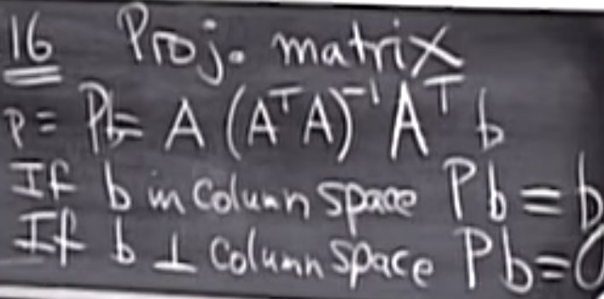
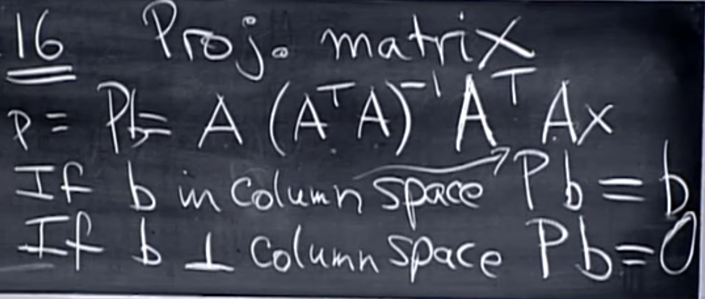
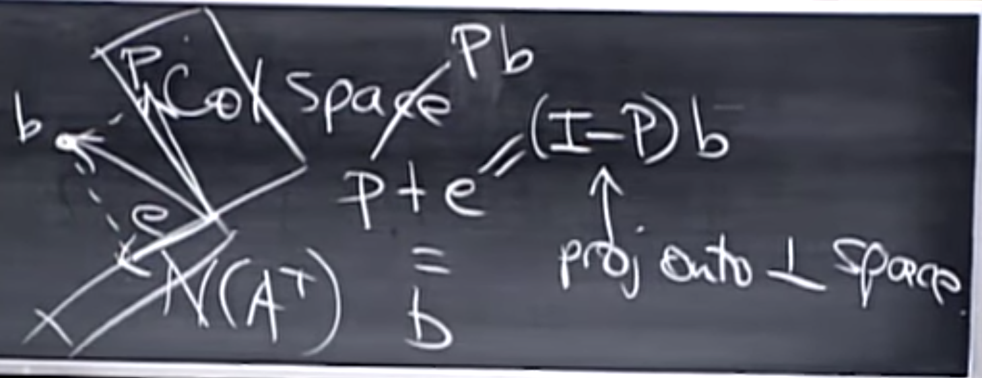
Projections
The results is cero
The results is b
Notes:
Evaluation of the two extremes cases

Slide 4
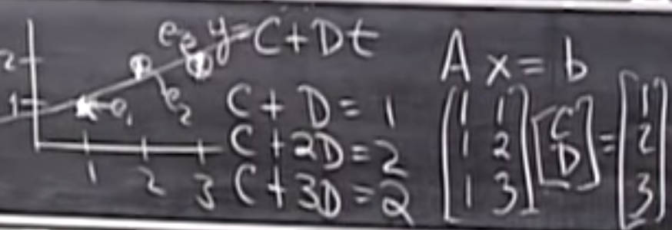
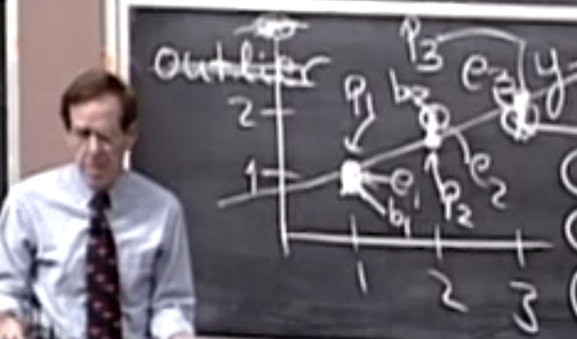
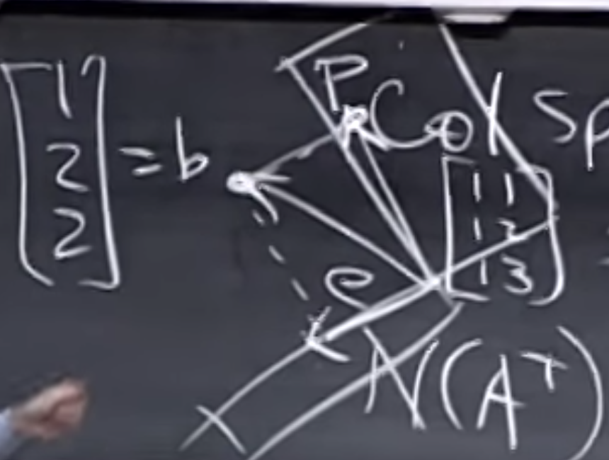
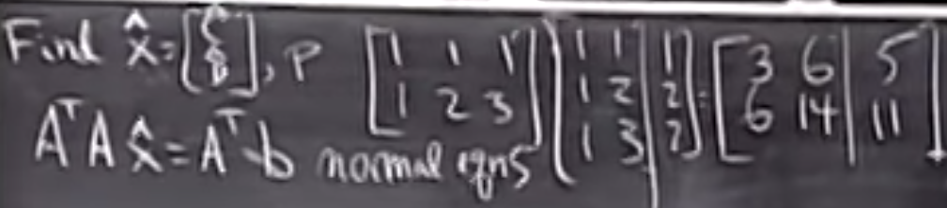
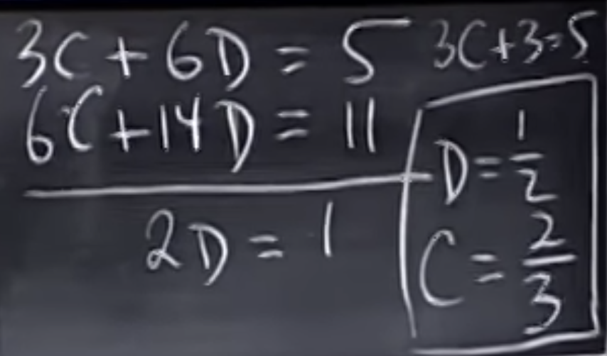
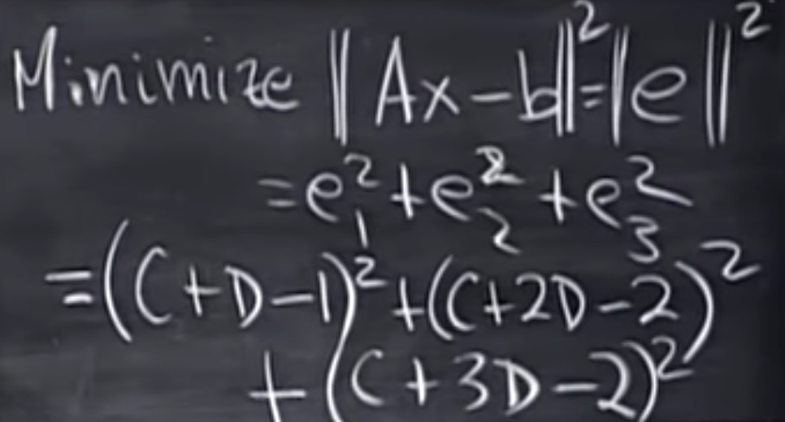
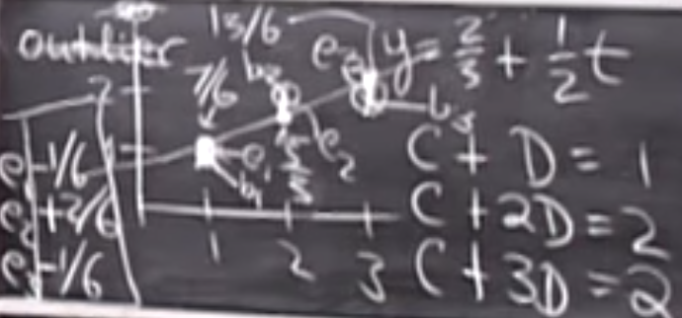
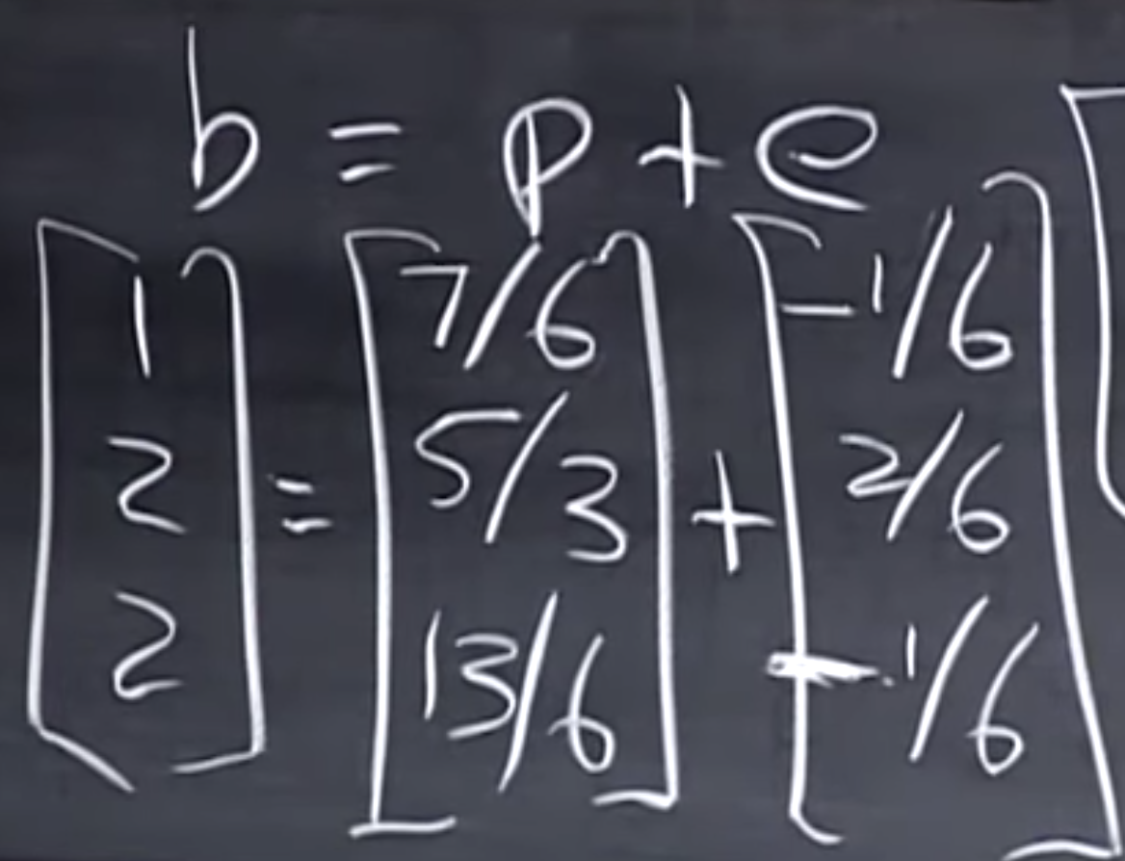

Least squares and best straight line
Notes:
Evaluation of the two extremes cases

Slide 5
Least squares and best straight line
Notes:
Evaluation of the two extremes cases

Slide 6
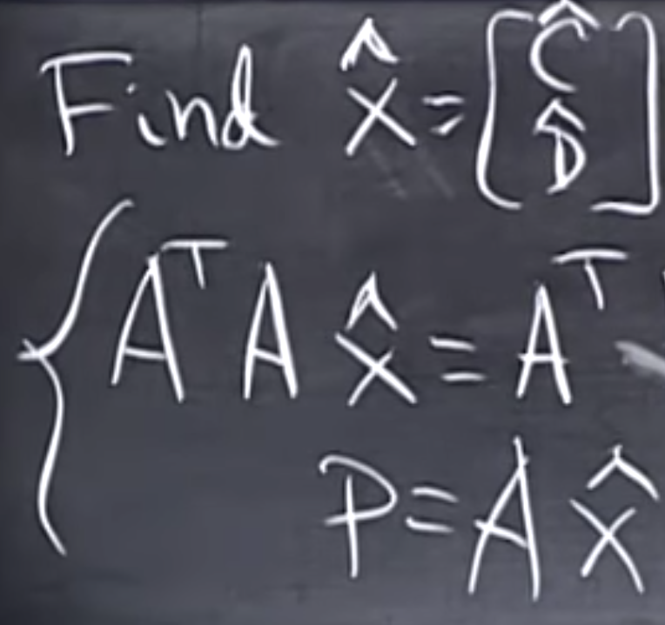
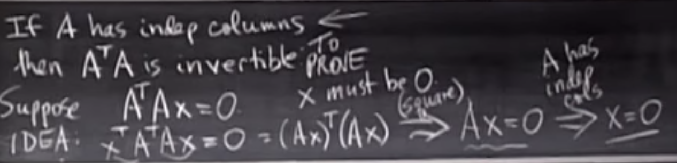
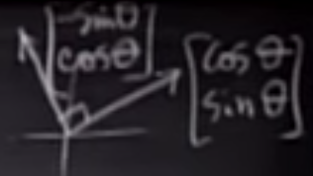
Least squares and best straight line
Notes:
Evaluation of the two extremes cases

Slide 7
Credits
https://github.com/aegiloru/linearAlgebra
https://ocw.mit.edu/courses/mathematics/18-06-linear-algebra-spring-2010/index.htm
Gilbert Strang Web Site
http://www-math.mit.edu/~gs/
http://math.mit.edu/~gs/linearalgebra/

Slide 8
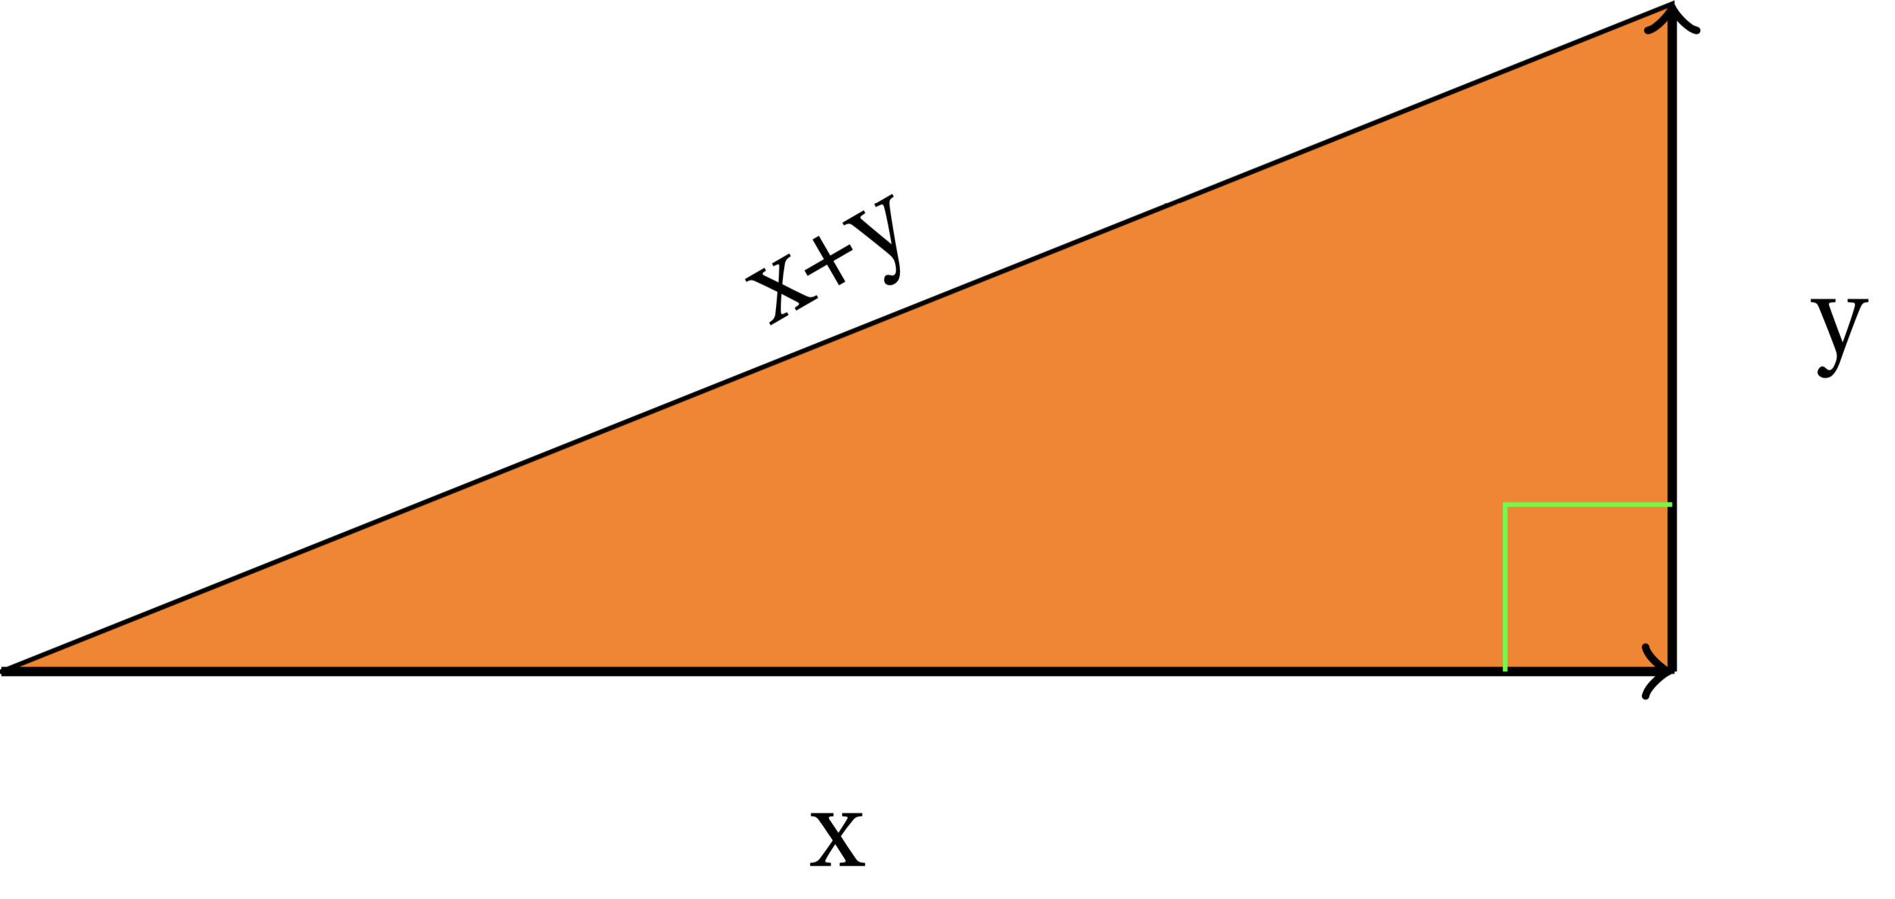

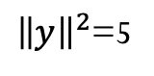
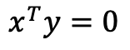
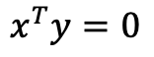
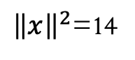
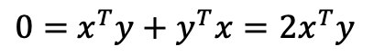
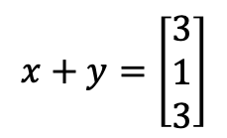
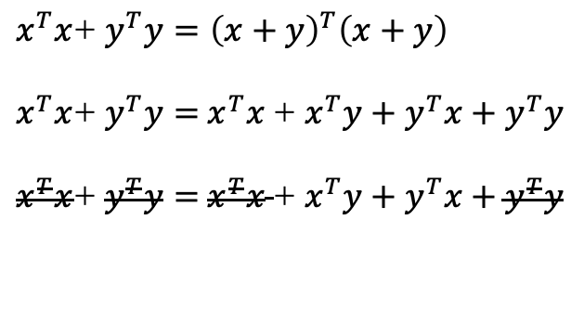
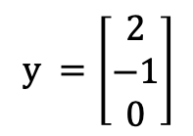
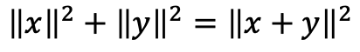
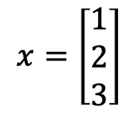
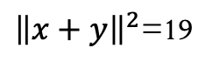
Orthogonal Vectors
$$x^{T}y=0$$
$${\left\|x\right\|}^{2}+{\left\|y\right\|}^{2}={\left\|x+y\right\|}^{2}$$
Pythagoras
$x^{T}x$+ $y^{T}y={\left(x+y\right)}^{T}\left(x+y\right)$
$x^{T}x$+ $y^{T}y=$ $x^{T}x$ + $x^{T}y+y^{T}x+y^{T}y$
$x^{T}x$+ $y^{T}y=$ $x^{T}x$ + $x^{T}y+y^{T}x+y^{T}y$
$$x=\left[\begin{matrix}1 \\ 2 \\ 3\end{matrix}\right]$$
$$y =\left[\begin{matrix}2 \\ −1 \\ 0\end{matrix}\right]$$
$$x+y=\left[\begin{matrix}3 \\ 1 \\ 3\end{matrix}\right]$$
$0=$ $x^{T}y+y^{T}x=2x^{T}y$
${\left\|x\right\|}^{2}$=14
${\left\|y\right\|}^{2}$=5
${\left\|x+y\right\|}^{2}$=19
Then
$$x^{T}y=0$$
$$∎$$
Q.E.D.

Slide 9
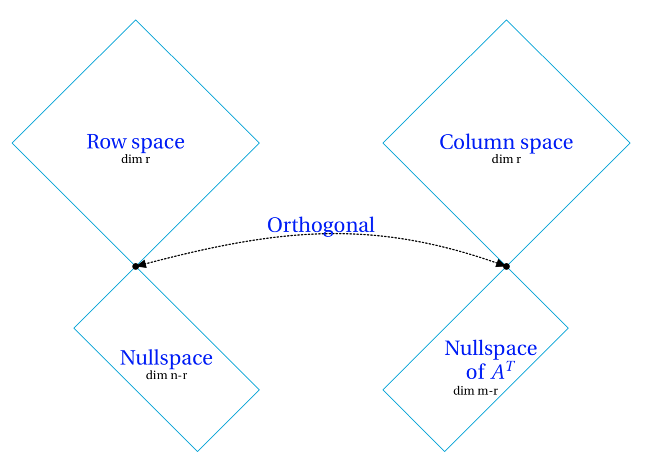

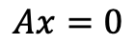
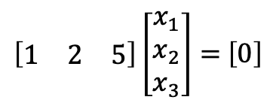
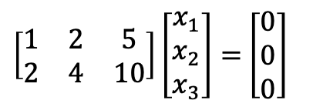
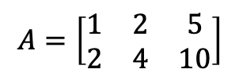
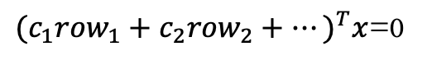
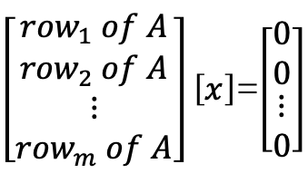

Subpace S is orthogonal to Subspace T
Means:
Row space is orthogonal
to nullspace
Every vector in S is orthogonal to every vector in T
Why?
$$Ax=0$$
$\left[\begin{matrix}{row}_{1} of A \\ {row}_{2} of A \\ \begin{matrix}⋮ \\ {row}_{m} of A\end{matrix}\end{matrix}\right]\left[x\right]$=$\left[\begin{matrix}0 \\ 0 \\ \begin{matrix}⋮ \\ 0\end{matrix}\end{matrix}\right]$
In the row space also it’s the linear combination
of row_{i}
$$A=\left[\begin{matrix}1 & 2 & 5 \\ 2 & 4 & 10\end{matrix}\right]$$
n=3, r=1
${{(c}_{1}{row}_{1}+c_{2}{row}_{2}+⋯)}^{T}x$=0
Dim N(A) = 2
$\left[\begin{matrix}1 & 2 & 5 \\ 2 & 4 & 10\end{matrix}\right]\left[\begin{matrix}x_{1} \\ x_{2} \\ x_{3}\end{matrix}\right]=$ $\left[\begin{matrix}0 \\ 0 \\ 0\end{matrix}\right]$
Nullspace and rowspace are
orthogonal complements in $ℝ^{n}$
$\left[\begin{matrix}1 & 2 & 5\end{matrix}\right]\left[\begin{matrix}x_{1} \\ x_{2} \\ x_{3}\end{matrix}\right]=$ $\left[0\right]$
Nullspace contains ALL vector $⊥$row space

Slide 10
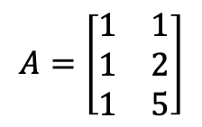

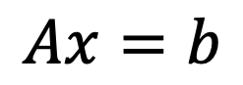

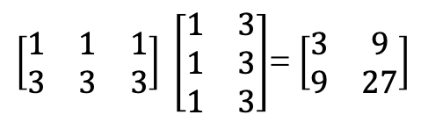
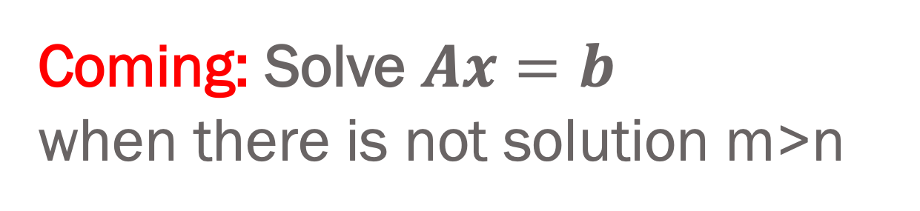
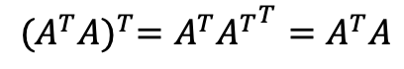
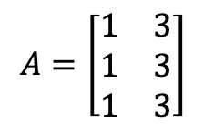
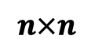
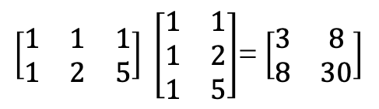
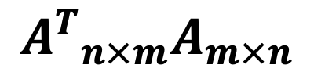
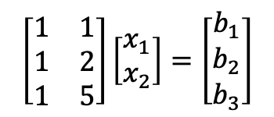
Coming: Solve $Ax=b$ when there is not solution m>n
$${A^{T}}_{n×m}A_{m×n}$$
$$Ax=b$$
$$n×n$$
$$A^{T}A\hat{x}=A^{T}b$$
symmetric
$${(A^{T}A)}^{T}=A^{T}{A^{T}}^{T}=A^{T}A$$
$$A=\left[\begin{matrix}1 & 1 \\ 1 & 2 \\ 1 & 5\end{matrix}\right]$$
$$\left[\begin{matrix}1 & 1 \\ 1 & 2 \\ 1 & 5\end{matrix}\right]\left[\begin{matrix}x_{1} \\ x_{2}\end{matrix}\right]=\left[\begin{matrix}b_{1} \\ b_{2} \\ b_{3}\end{matrix}\right]$$
$\left[\begin{matrix}1 & 1 & 1 \\ 1 & 2 & 5\end{matrix}\right] \left[\begin{matrix}1 & 1 \\ 1 & 2 \\ 1 & 5\end{matrix}\right]$= $\left[\begin{matrix}3 & 8 \\ 8 & 30\end{matrix}\right]$
r=2
$$A=\left[\begin{matrix}1 & 3 \\ 1 & 3 \\ 1 & 3\end{matrix}\right]$$
$\left[\begin{matrix}1 & 1 & 1 \\ 3 & 3 & 3\end{matrix}\right] \left[\begin{matrix}1 & 3 \\ 1 & 3 \\ 1 & 3\end{matrix}\right]$= $\left[\begin{matrix}3 & 9 \\ 9 & 27\end{matrix}\right]$
r=1
$A^{T}A$is invertible exactly if $A$has independents columns
$${N(A}^{T}A)=N(A)$$

